Slide 1
UML Modeling
Instructor: Muhammad Zeeshan Nazar

Slide 2
How are design ideas communicated in a team environment?
If the software is large scale, employing perhaps dozens of developers over several years, it is important that all members of the development team communicate using a common language.
This isn’t meant to imply that they all need to be fluent in English or C++, but it does mean that they need to be able to describe their software’s operation and design to another person.
That is, the ideas in the head of say the analyst have to be conveyed to the designer in some way so that he/she can implement that idea in code.
Just as mathematicians use algebra and electronics engineers have evolved circuit notation and theory to describe their ideas, software engineers have evolved their own notation for describing the architecture and behaviour of software system.
That notation is called UML. The Unified Modelling Language. Some might prefer the title Universal Modelling language since it can be used to model many things besides software.

Slide 3
What is UML ?
UML is not a language in the same way that we view programming languages such as C++, Java or Python.
UML is however a language in the sense that it has syntax and semantics which convey meaning, understanding and constraints to the reader and thereby allows two people fluent in that language to communicate and understand the intention of the other.
UML represents a collection of graphical notations to capture requirements and design alternatives.
UML is to software engineers what building plans are to an architect and an electrical circuit diagrams is to an electrician.
UML is suitable for large scale projects.

Slide 4
Models and Multiple Views
UML is used to model (i.e., represent) the system being built.
It is impossible to capture all the subtle details of a complex software system in just one large diagram.
The UML has numerous types of diagrams, each providing a certain view of your system

Slide 5
Diagram Taxonomy
UML diagrams can be classified into two groups: structure diagrams and behavior diagrams.
System complexity is driven both by the number and organization of elements in the system (i.e., structure) and the way all these elements collaborate to perform their function (i.e., behavior).

Slide 6
Structure Diagrams
These diagrams are used to show the static structure of elements in the system, architectural organization of the system, the physical elements of the system, its runtime configuration.
Structure diagrams are often used in conjunction with behavior diagrams to depict a particular aspect of your system. Each class may have an associated state machine diagram that indicates the event-driven behavior of the class’s instances.
Following are the Structure Diagrams in UML:
■ Package diagram
■ Class diagram
■ Component diagram
■ Deployment diagram
■ Object diagram
■ Composite structure diagram

Slide 7
Behavior Diagrams
Events happen dynamically in all software-intensive systems: Objects are created and destroyed, objects send messages to one another in an orderly fashion, external events trigger operations on certain objects.
Following are the Behavior Diagrams in UML:
■ Use case diagram
■ Activity diagram
■ State machine diagram
■ Interaction diagrams
■ Sequence diagram
■ Communication diagram
■ Interaction overview diagram
■ Timing diagram

Slide 8
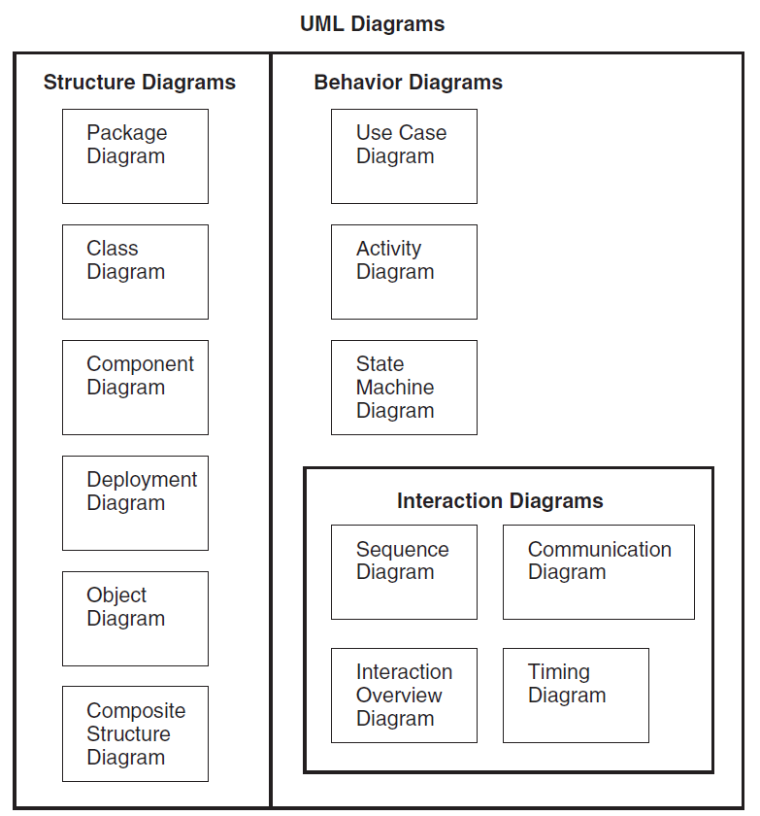
UML Diagrams

Slide 9
Definition of a Use-Case
A process or procedure, describing a user’s interaction with the system (e.g. library) for a specified, identifiable purpose. (e.g. borrowing a book).
As such, each Use-Case describes a step-by-step sequence of operations, iterations and events that document
The Interaction taking place.
The Measurable Benefits to the user interacting with the system
The Effect of that Interaction on the system.
It is important to document these use-cases as fully as possible as each use-case captures some important functionality that our system will have to provide.
Notes:
Each use case represents a discrete goal for the user

Slide 10
Use Cases in Iterative Development
Functional requirements are primarily captured in use cases
Use cases drive the iteration planning and work
Easy for users to understand

Slide 11
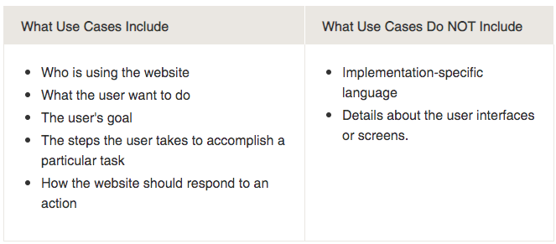
What ‘should’ and what ‘shouldn’t’ be included in use cases?

Slide 12
How to Find Use Cases?
Choose the system boundary
what are you building?
who will be using the system?
what else will be used that you are not building?
Find primary actors and their goals
brainstorm the primary actors first who starts and stops the system?
who gets notified when there are errors or failures?
Define use cases that satisfy user goals
prepare an actor-goal list in general, one use case for each user goal
name the use case similar to the user goal

Slide 13
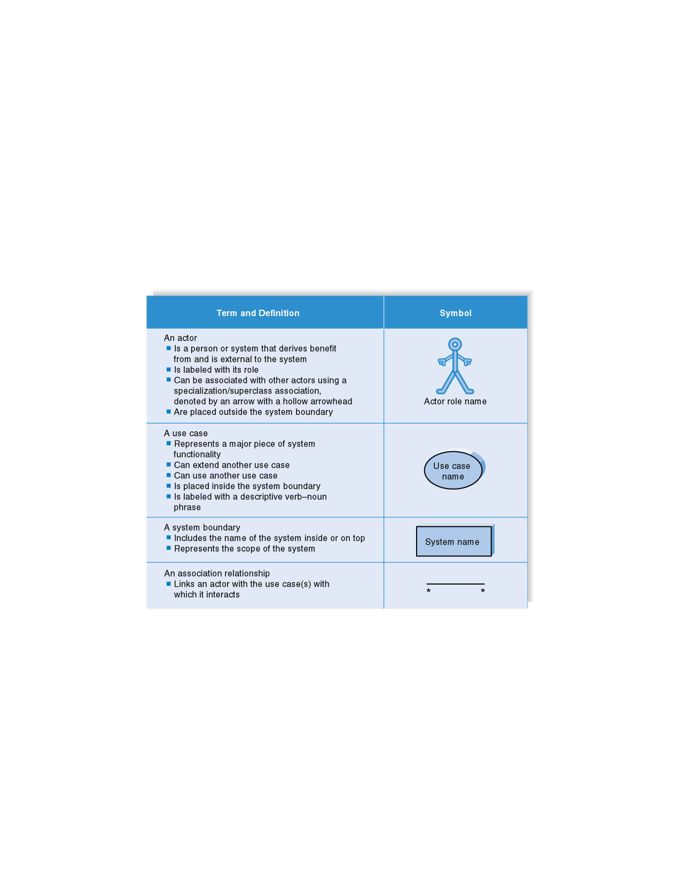

Syntax for Use Case Diagram
Notations
Name of the system

Slide 14

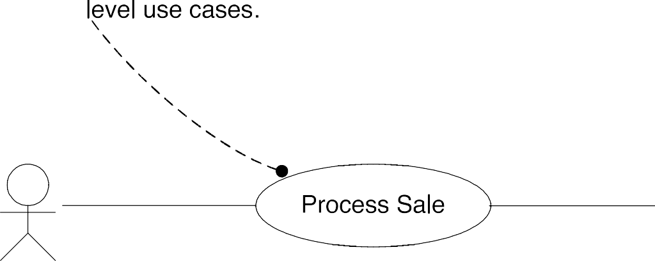

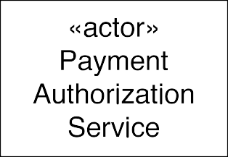

Use Case (Context) Diagrams: Suggested Notation
secondary/supporting actors on the right

Slide 15
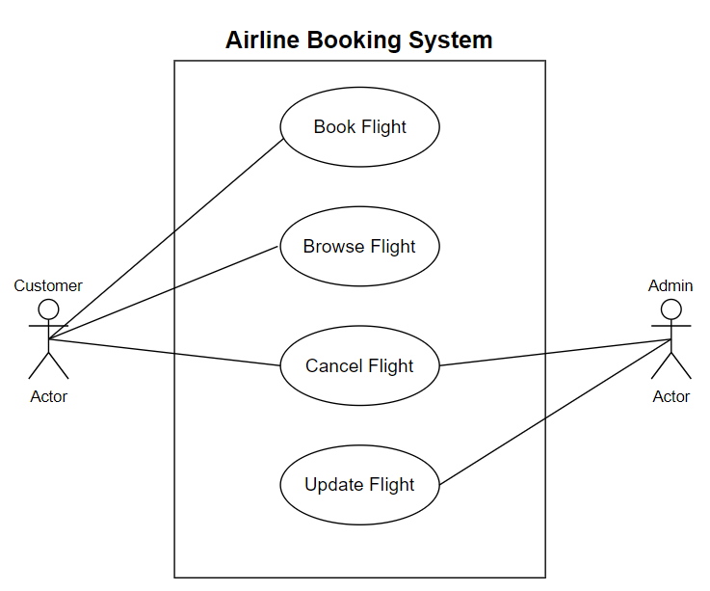
Use Case Diagram for Airline Booking System
Secondary Actor
Primary Actor

Slide 16
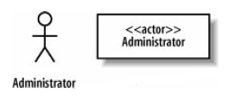
Example
The requirement indicates that the Administrator interacts with the system to create a new blogger's account
Requirement 1
The content management system shall allow an administrator to create a new blog account, provided the personal details of the new blogger are verified using the author credentials service.
The
Administrator interacts with the system and is not part of the system; thus, the Administrator
Is an Actor.
It's actually worth being very careful when naming your actors. The best approach is to use a name that can be understood by both your customer and your system designers.

Slide 17

Example
What can be the use case in our Requirement 1?
to create a new blog account
Requirement 1
The content management system shall allow an administrator to create a new blog account, provided the personal details of the new blogger are verified using the author credentials service.
UML Representation

Slide 18
Example (Cont)
Requirement 2
The content management system shall allow an administrator to create a new personal Wiki, provided the personal details of the applying author are verified using the Author Credentials Service.

Slide 19
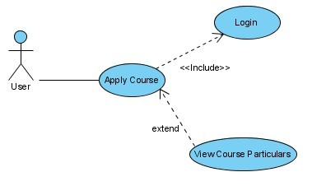
Example of Stereotypes – Include and Extend
Slide 2 (of 48)

Slide 20
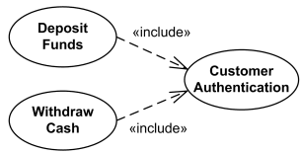
Example – Include and Extend
User
Slide 2 (of 48)

Slide 21
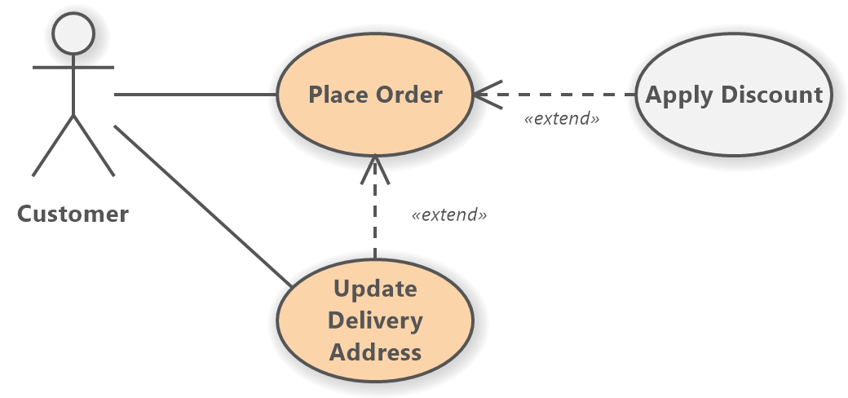
Example – Include and Extend
Slide 2 (of 48)

Slide 22
Include and Extend Relationships
The use of include and extend is discouraged simply because they add unnecessary complexity to a Use Case diagram.
Only use them if they are necessary.
Slide 2 (of 48)

Slide 23
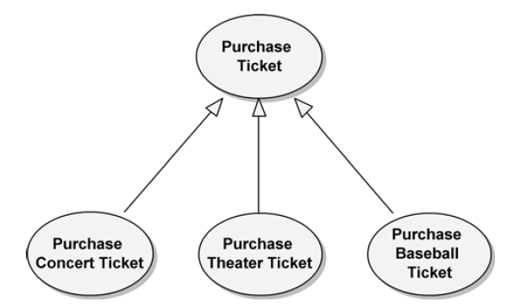
Generalization
Generalization relationships can also be used to relate use cases. As with classes, use cases can have common behaviors that other use cases (i.e., child use cases) can modify by adding steps or refining others.
Purchase Ticket contains the basic steps necessary for purchasing any tickets, while the child use cases specialize Purchase Ticket for the specific kinds of tickets being purchased.

Slide 24
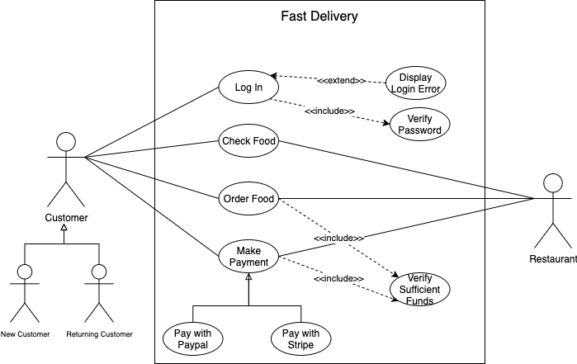
Example

Slide 25
References
Object-Oriented Analysis and Design with Applications, Grady Booch et al., 3rd Edition, Pearson, 2007.
Timothy C. Lethbridge, Robert Laganaiere, Object-Oriented Software Engineering (2nd Edition), McGraw Hill, 2005
Object-Oriented Modeling and Design with UML, Michael R. Blaha and James R. Rumbaugh, 2nd Edition, Pearson, 2005.
Larman, Craig. Applying UML and patterns: an introduction to object oriented analysis and design and interative development. Pearson Education India, 2012.

